Slide 1
Big Thinking Questions
TERM 5 AND 6

Slide 2
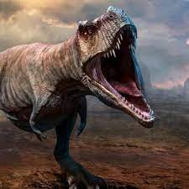
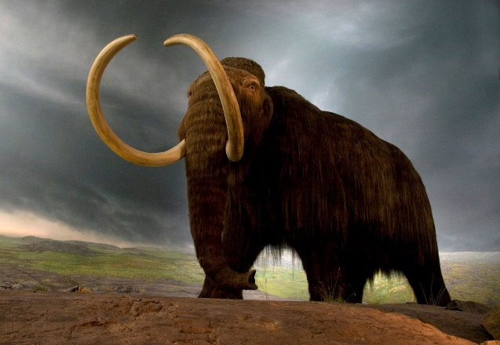
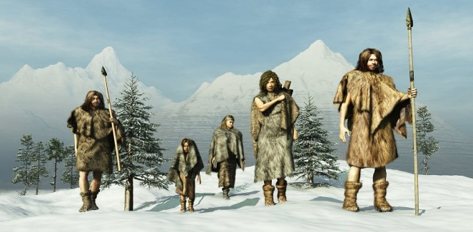
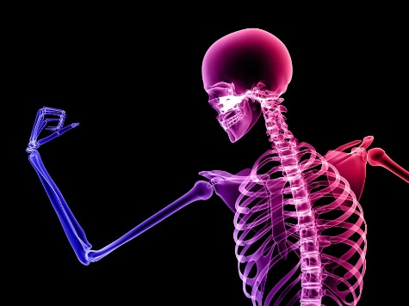
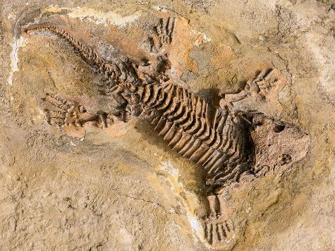
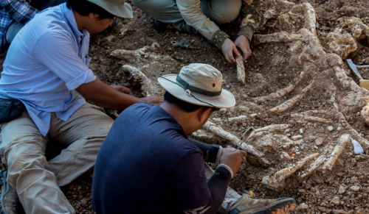
keywords
Dinosaur Extinct Prehistoric
Bones Fossils Palaeontologist
Notes:
Dinosaur: A special kind of animal that lived on land a long time ago.
Extinct: No longer alive we cannot see them in the world we live in.
Prehistoric: A very long time ago.
Bones: Hard parts of the body which make up a skeleton.
Fossils: Fossils are parts of an animal which have made marks within the rock and has turned to rock itself over millions of years.
Palaeontologist: A scientist who explores prehistoric times.

Slide 3
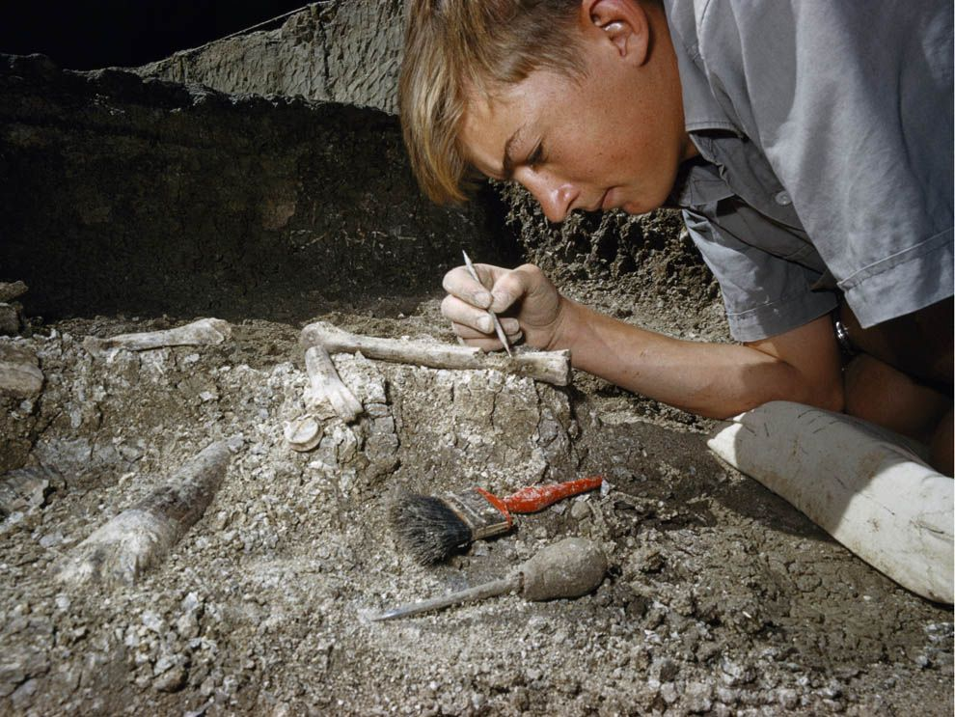
What is a dinosaur?
LGfL VideoCentral HD
Palaeontologist = a scientist who studies the Earth to see what was alive a long time ago.

Slide 4
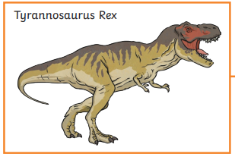
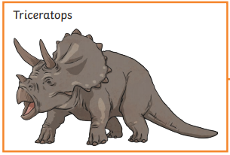
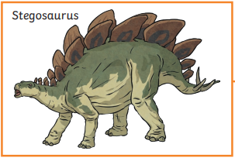
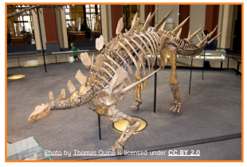
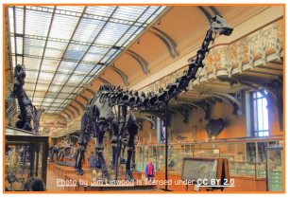
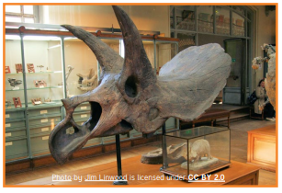
What is a fossil?
Play from 3:05 – 3:50
Geography KS1: Fossil hunting along the Jurassic Coast - BBC Teach
An old bone from a long time ago.
So how do we know dinosaurs were real?
What proof do we have that dinosaurs existed?
Notes:
We have lots of fossils for some dinosaurs but not all species, so we have to make lots of guesses about what they looked like and what they did.

Slide 5
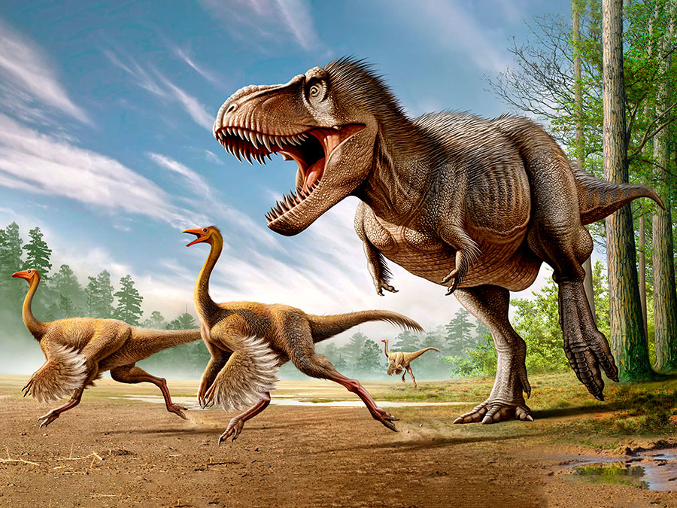
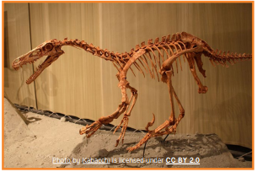
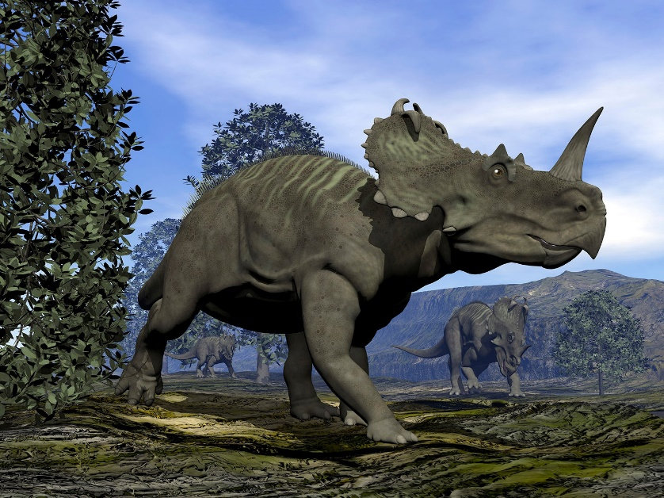
Photos of dinosaurs
Are these real photos?
How do you know?
How do we know what dinosaurs used to look like?
Notes:
Photo underneath the writing – Children may notice this is a real dinosaur because all the fossils have been put together but no one has ever seen a dinosaur as they lived millions of years ago.
Scientists think they know what dinosaurs looked like because fossils have been put together to make a clearer picture.

Slide 6
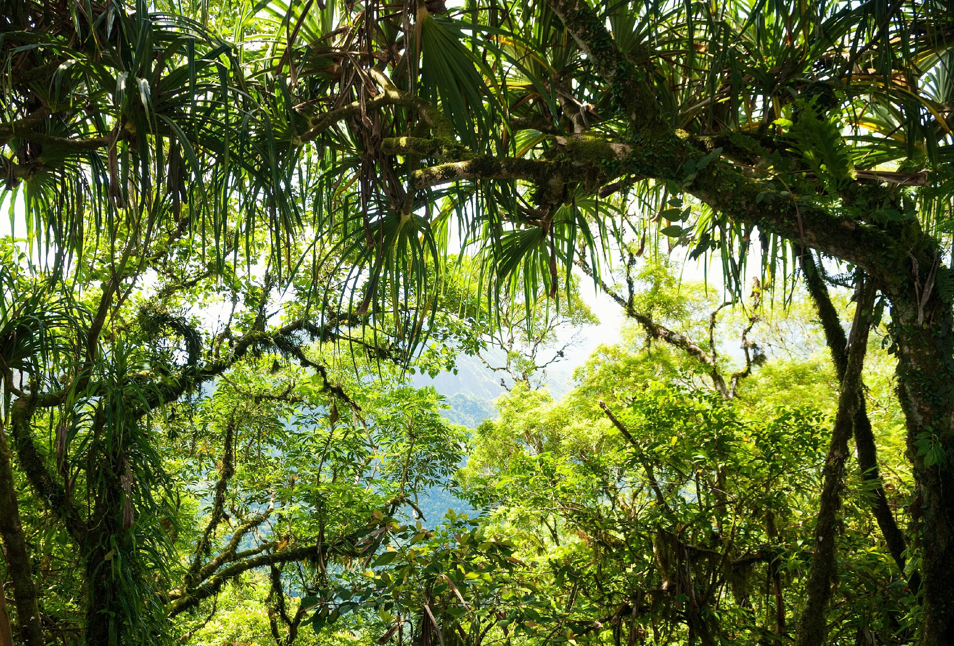
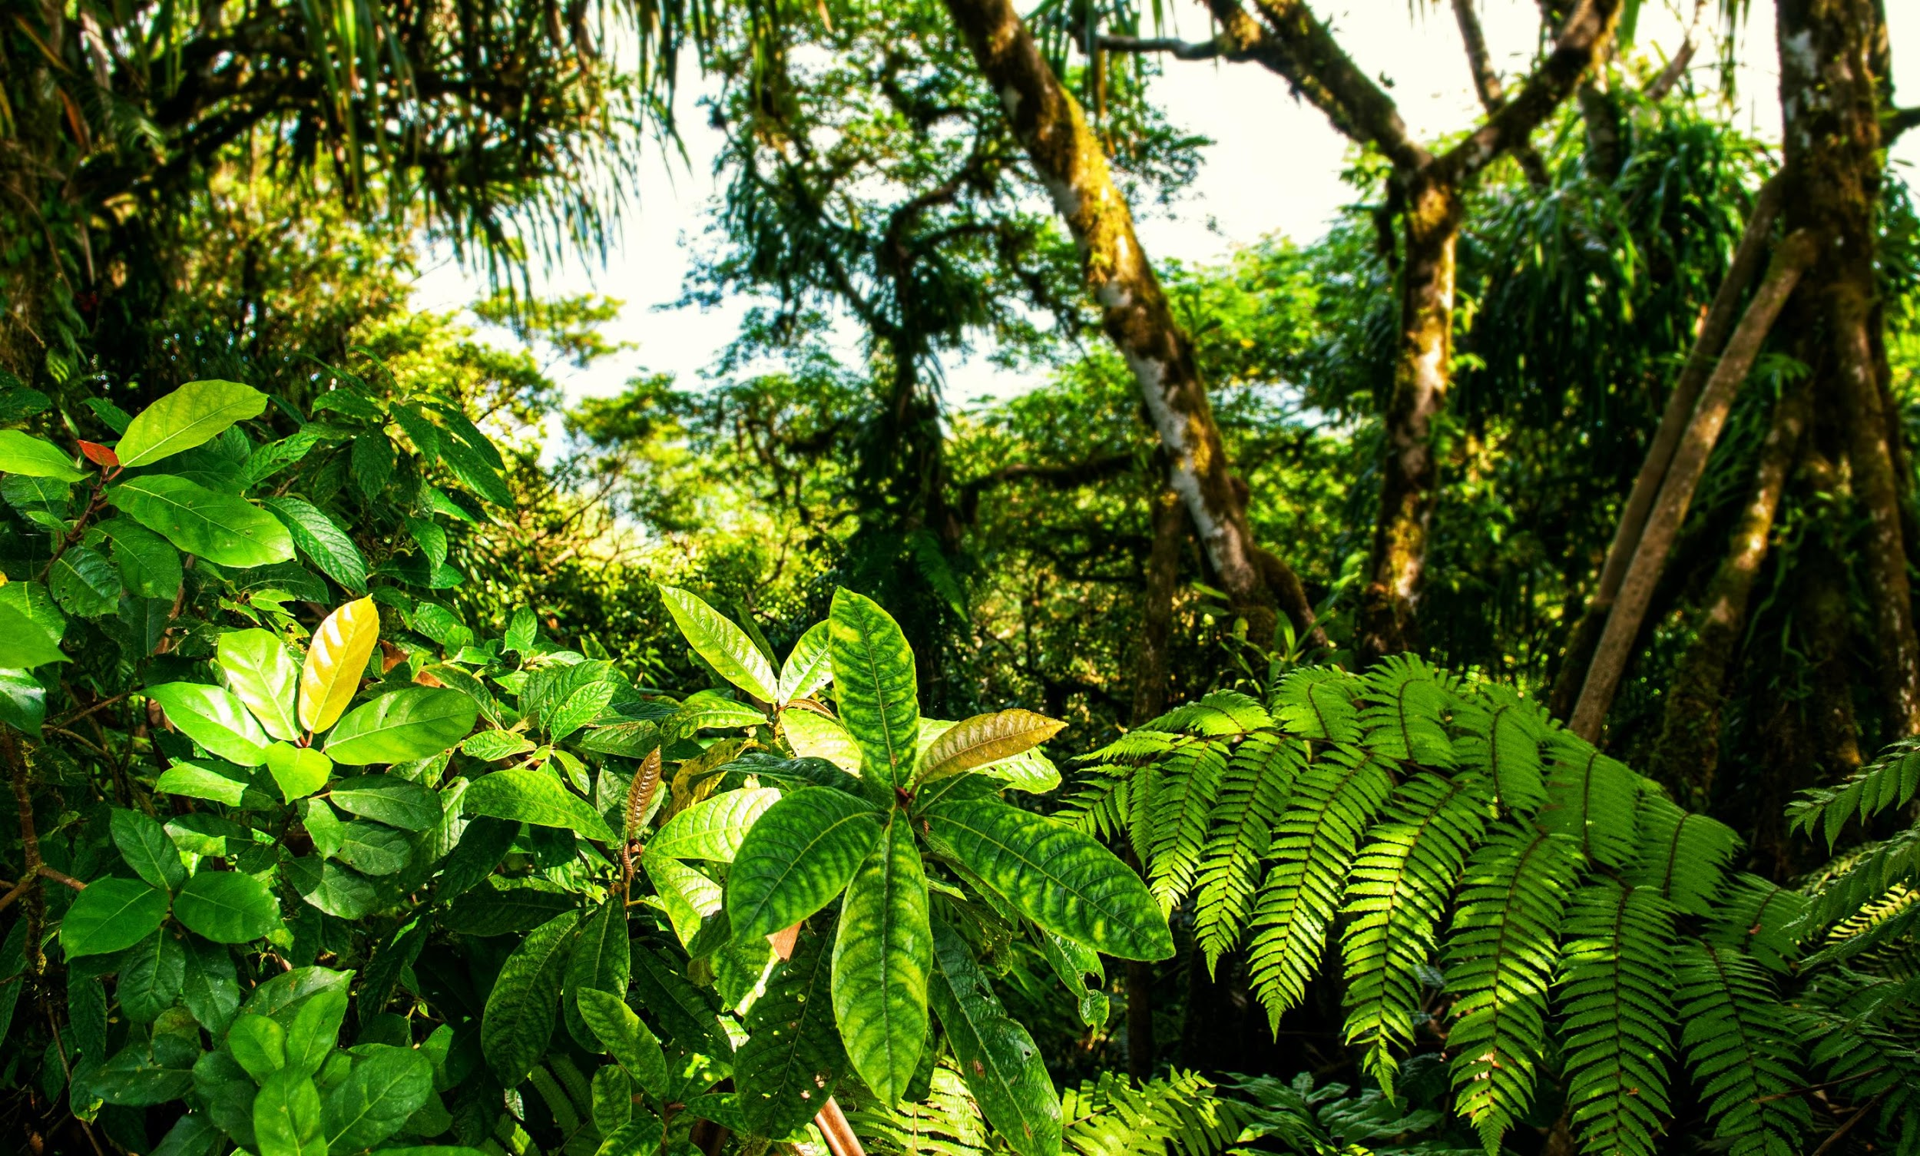
Did we have dinosaurs in Great Britain?
https://lgfl.planetestream.com/Embed.aspx?id=3264&code=ax~jFlHQVAdxJlBicT2PDxynF&oc=1
Great Britain would have looked very different a long time ago, there were no buildings because there were no people and the weather was very different to the weather we have now!
Notes:
(That dinosaurs lived somewhere hot and how very different Great Britain looked in prehistoric times).
David describes how we know where dinosaurs lived in Britain. He shows examples of dinosaur footprints and some of the plants that dinosaurs would have eaten.

Slide 7

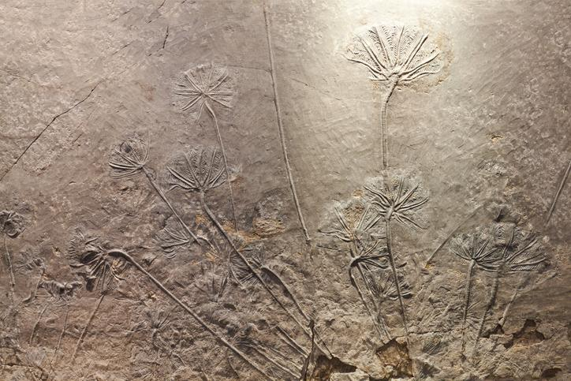
Notes:
Print out the fossils PDF cards, divide your class into small groups. Give each group a set of cards (and if you can, give each group a magnifying glass).
Looking closely at the fossils on the slides:- What can the children see? Can they guess the objects/items?

Slide 8
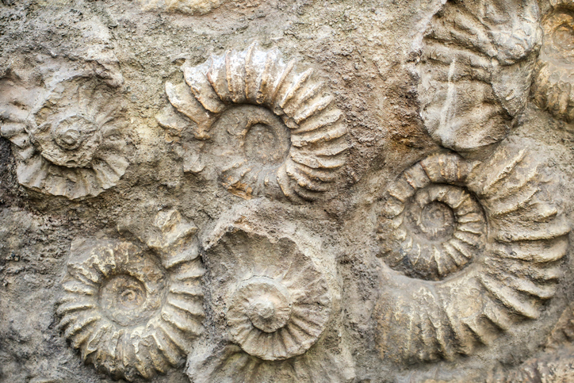
Notes:
Print out the fossils PDF cards, divide your class into small groups. Give each group a set of cards (and if you can, give each group a magnifying glass).
Looking closely at the fossils on the slides:- What can the children see? Can they guess the objects/items?

Slide 9
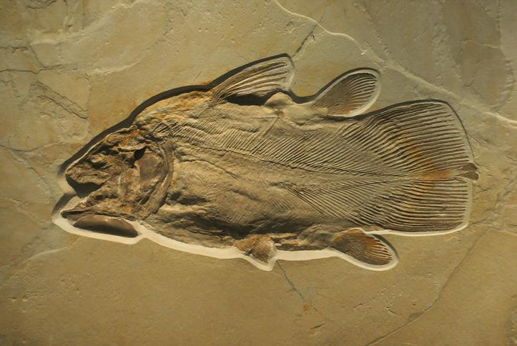
Notes:
Print out the fossils PDF cards, divide your class into small groups. Give each group a set of cards (and if you can, give each group a magnifying glass).
Looking closely at the fossils on the slides:- What can the children see? Can they guess the objects/items?

Slide 10
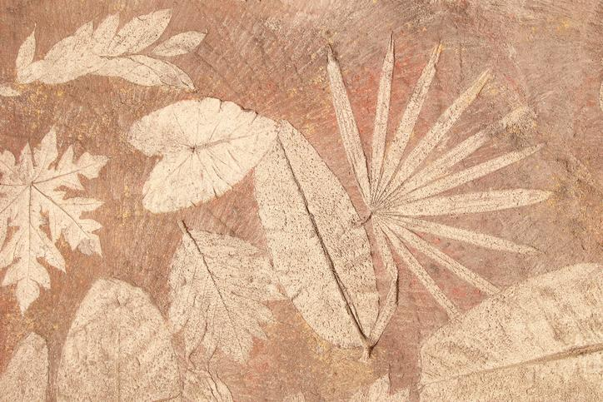
Notes:
Print out the fossils PDF cards, divide your class into small groups. Give each group a set of cards (and if you can, give each group a magnifying glass).
Looking closely at the fossils on the slides:- What can the children see? Can they guess the objects/items?

Slide 11
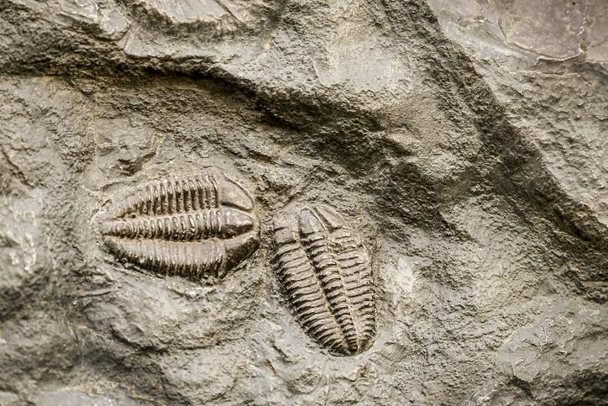
Notes:
Print out the fossils PDF cards, divide your class into small groups. Give each group a set of cards (and if you can, give each group a magnifying glass).
Looking closely at the fossils on the slides:- What can the children see? Can they guess the objects/items?

Slide 12
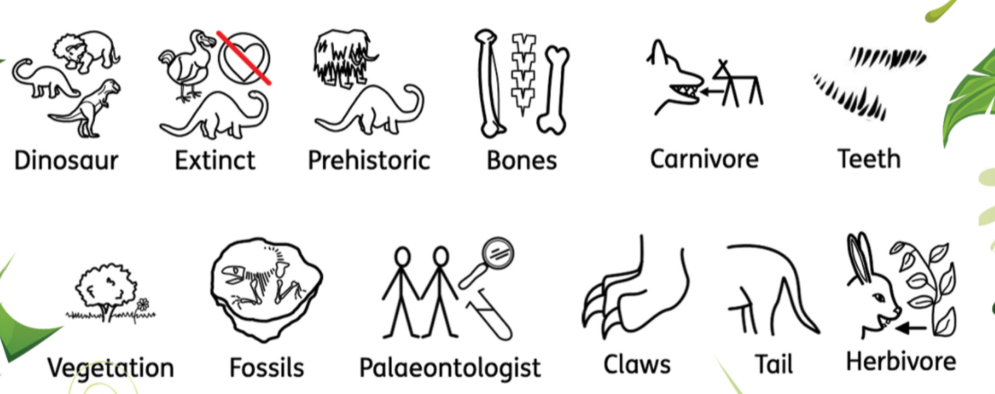
What do our keywords mean?
How do you know?

